Slide 1



Group 10
CSE115
Section 2
Project
2025
WORD GENERATOR
WORD GENERATOR
WORD GENERATOR

Slide 2


Group 10
CSE115
Section 2
Project
2025
Introduction
This project created using C program that places words in a 10x10 character grid in horizontal, vertical, and diagonal orientations. It is created with basic operations and functions and still in development. The program is designed to demonstrate structured placement of words within a fixed-size grid, ensuring proper boundary checks to prevent overflow.

Slide 3
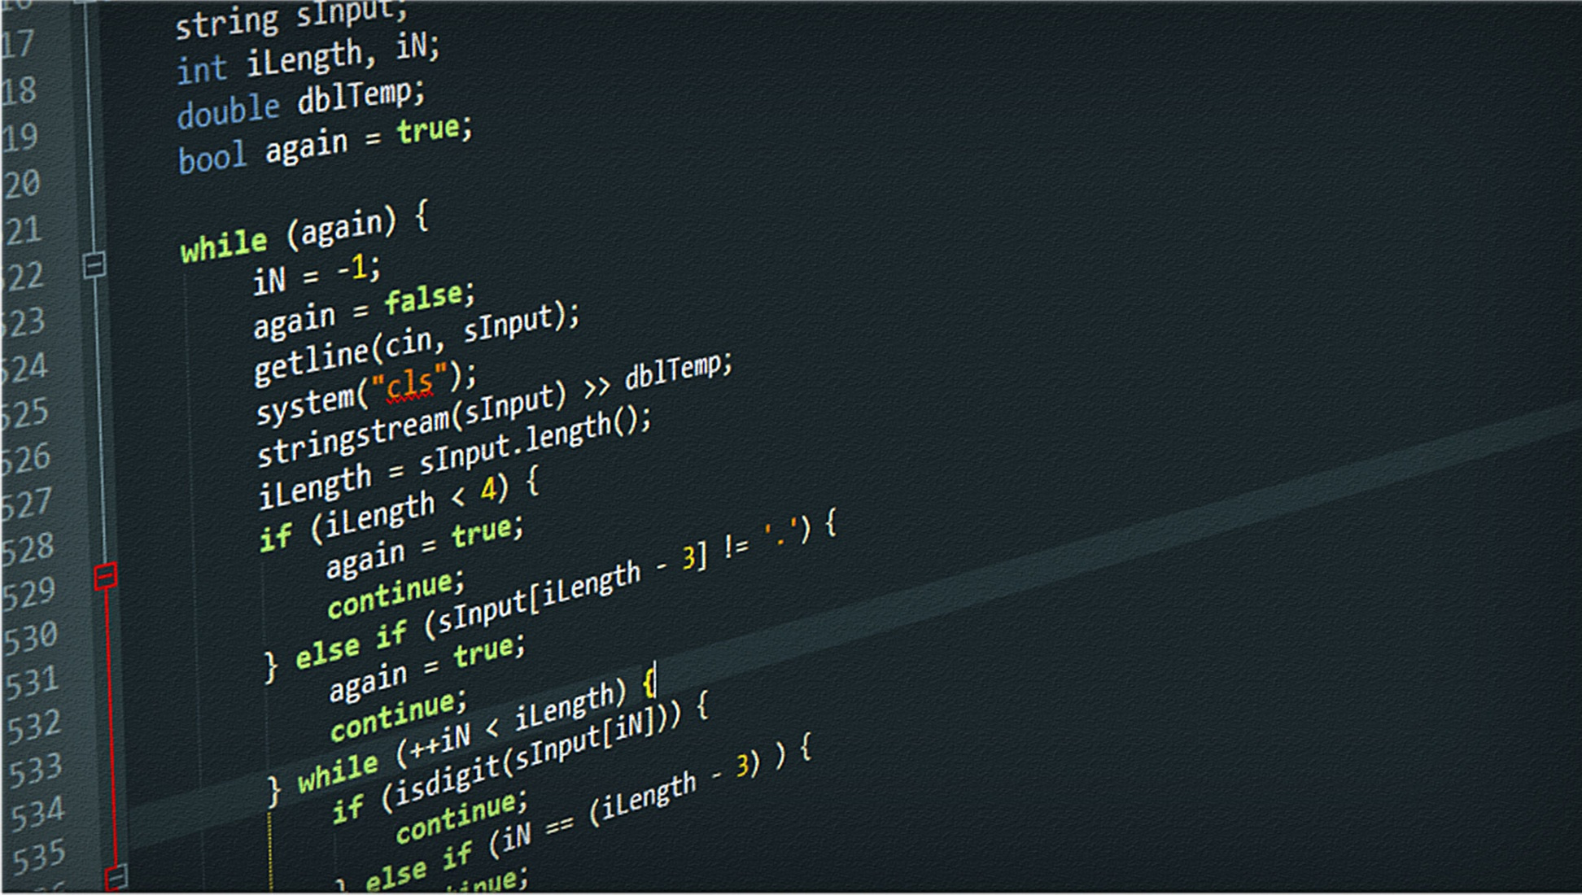
Group 10
CSE115
Section 2
Project
2025
Significance
PRACTICAL APPLICATION
This implementation is foundational for word search puzzles, text-based games, and crossword generators.This word generator will help learners to learn new words and it will help in the process of critical thinking.

Slide 4
Group 10
CSE115
Section 2
Project
2025
Significance
EFFICIENCY
The algorithm efficiently places words while preventing out-of-bounds errors

Slide 5
Group 10
CSE115
Section 2
Project
2025
Significance
MODULARITY
Functions allow easy modifications and scalability so that it can be made into larger grids or different placement orientations.

Slide 6

Group 10
CSE115
Section 2
Project
2025
Methodology
GRID INITIALIZATION
In this progam a 10x10 grid is initialized with '.' characters. And with this kind of character, the whole grid is made.

Slide 7
Group 10
CSE115
Section 2
Project
2025
Methodology
WORD PLACEMENT FUNCTIONS
placeHorizontal():This function places words from left to right.
placeVertical(): This function places words from top to bottom.
placeDiagonal():This function places words diagonally from top-left to bottom-right.

Slide 8
Group 10
CSE115
Section 2
Project
2025
Methodology
GRID BOUNDARY CHECKING
The program ensures words fit within the grid before placement. And the final grid will be printed to show the word placement.

Slide 9
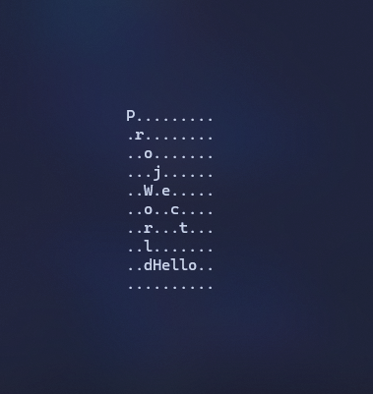
Group 10
CSE115
Section 2
Project
2025
Results& Conclusion
This project is successfully initializes the grid right now. And it helps to place specified words to place accurately in three dimensions. The program demonstrates structured word placement which is essential for word-based games or generators.

Slide 10

Group 10
CSE115
Section 2
Project
2025
Future Works
USER EXPERIENCE
In future,this generator will feature a much larger grid and increased number of words to enhance the challenge. the words will randomly generate each time the program runs. A visually appealing CLI with ASCll art will be displayed above the grid. The generator will allow users to guess the words interactively and correctly identified words will be removed from the grid. A score tracker will also display the game progress which will help users to track their performance.

Slide 11
Group 10
CSE115
Section 2
Project
2025
THANK YOU
THANK YOU
THANK YOU

